Slide 1
THE SEVEN STEP GUIDE
PRESENTERS :
Paul Opiyo
Benjamin Mumasi.

Slide 2
1.
WHY ABROAD???

Slide 3


Slide 4



Slide 5
Things to consider.
Academic interests: Medicine, Law, African Studies
Types of schools and their curricular structures
Financial aid
Opportunities: Internships, Work experiences

Slide 6
Things to consider
Environment: climate, culture, foreign laws for students e.g Curricular Practical Training (CPT), Optional Practical Training (OPT) for students on work study
Problem-solving approach
Extensive Research

Slide 7
2.
THE APPLICATION

Slide 8
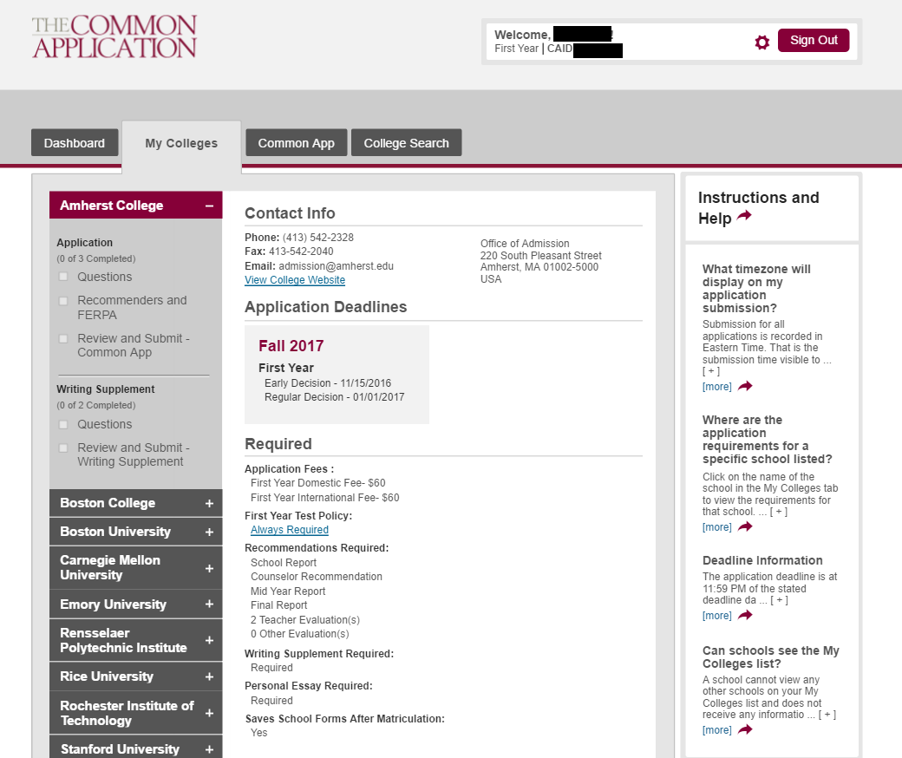
THE COMMON APPLICATION

Slide 9
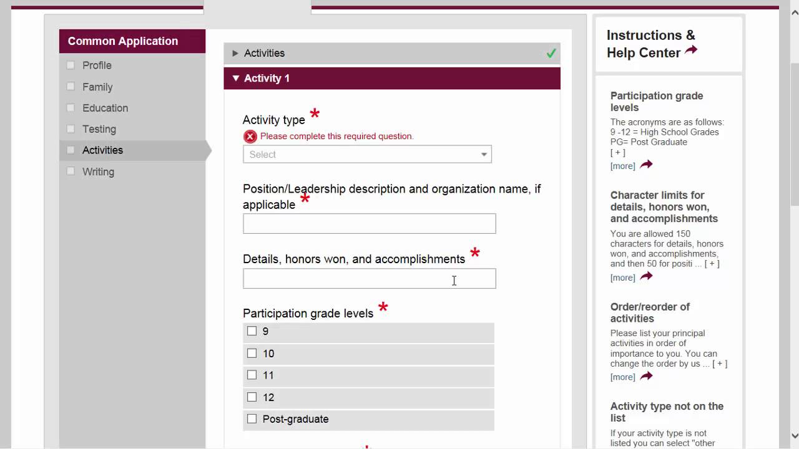
Sections !

Slide 10
SCHOOL SPECIFIC SITES
MIT
Uchicago
University of Cape Town
University of Edinburgh

Slide 11
3.
DOCUMENTATION

Slide 12
For common app:
KCSE result slip.
Transcripts.
Recommendation letters
School Report
Fee waiver form and a supporting letter.
Early Decision Agreement.
School Profile

Slide 13
4.
ESSAYS

Slide 14
You’ll need to write:
Common App essay
Supplementary essays
Additional information

Slide 15
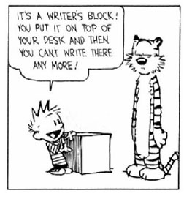

Slide 16
5.
TESTS

Slide 17
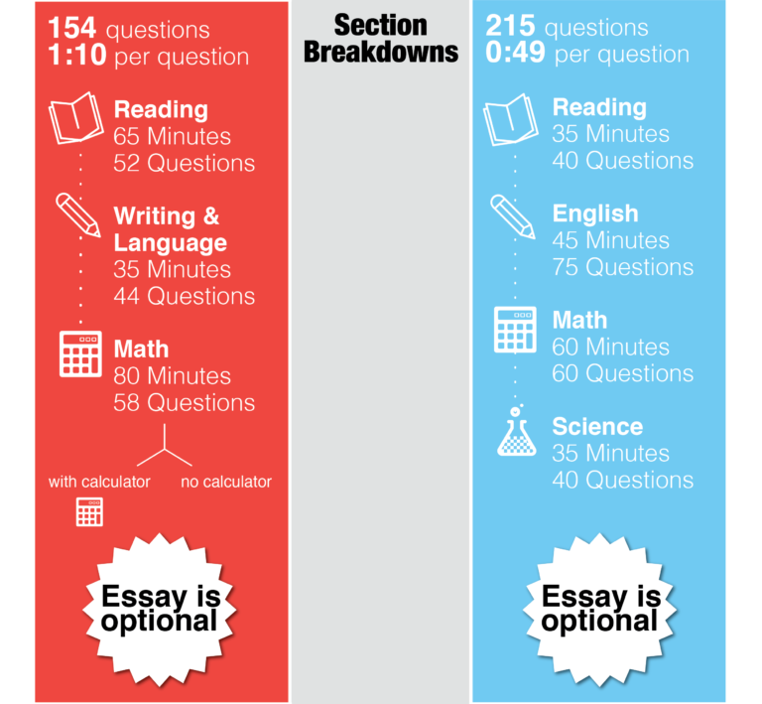
SAT & ACT

Slide 18
SAT
Content:
Critical reading.
Math.
Writing.
Essay.

Slide 19
ACT
Content:
English writing
Reading
Math
Science
Essay

Slide 20
ENGLISH ADMISSION TESTS
DUOLINGO ENGLISH TEST
TOEFL

Slide 21
6.
FINANCIAL AID

Slide 22
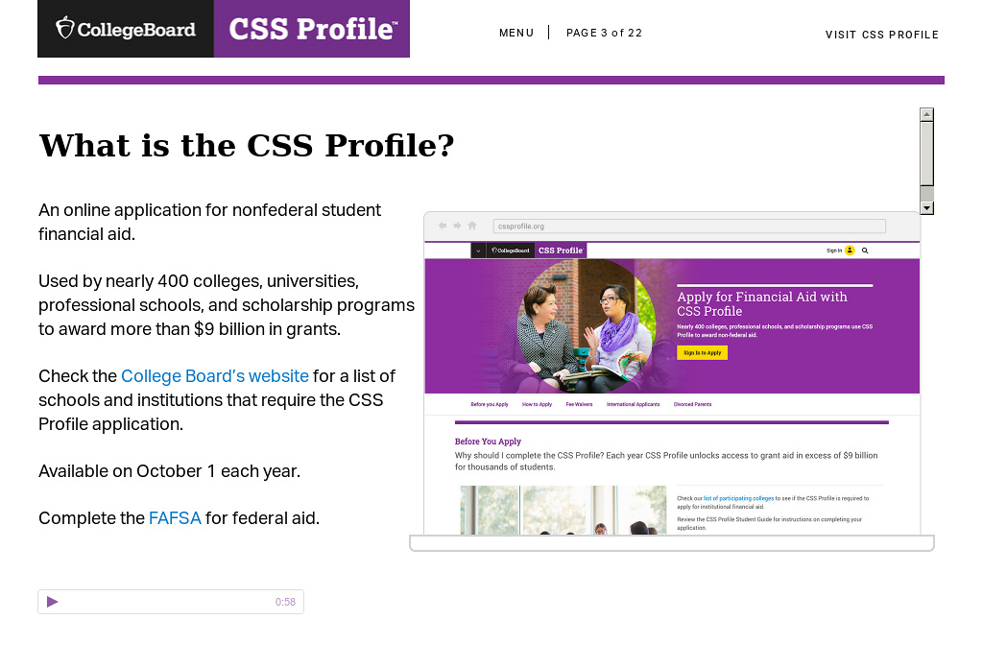
CSS Profile

Slide 23
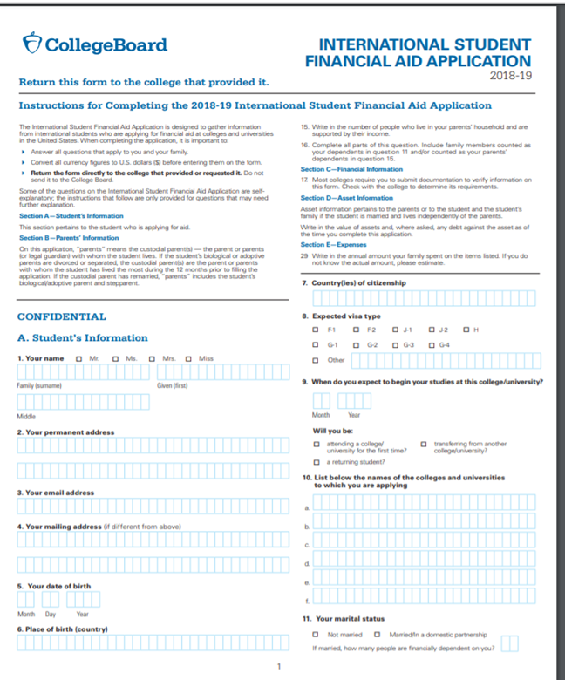
ISFAA

Slide 24
TYPES OF FINANCIAL AID
Foundation and organization scholarship – MCF & Botstiber
Private scholarships
School specific scholarships e.g Karen McKellin International Leader of Tomorrow Award for UBC

Slide 25
MCF Schools
Duke – Not Charles
University of Edinburgh
Ashesi
EARTH – Not the one in The Milky Way
University of Cape Town

Slide 26
7.
SUBMITTING THE APPLICATION

Slide 27
DEADLINES
Early Decision –November 1St to 15th (Documents should be submitted by 1st November 2019)
Early Decision II-varies
Regular Decision-1st to 15th January (Documents should be submitted by 27th December 2019)

Slide 28
RESOURCES
Common App
https://apply.commonapp.org/Login?sto=1
College Board
https://collegereadiness.collegeboard.org/sat/register
Tests and Deadlines
https://collegereadiness.collegeboard.org/sat/register/dates-deadlines

Slide 29
Q&A
.

Slide 30
THE END
THANK YOU

